Slide 1

Mortgage Analysis
By Kimberly Summerville

Slide 2



Problem Statement
Will this housing market continue to rise, level off, or decline?
Notes:
Despite a global pandemic, the United States real estate market has been on a meteoric rise in 2020-2021.
Even though prices increased, the work-from-home culture and the record low interest rates have contributed to the demand for housing increasing with them.
Even my house that I just bought 4 years ago has increased in value by over 25%!
This unprecedented market has affected the mortgage industry too.
From first time home buyers applying for mortgages to get in on the boom to long time homeowners refinancing to take advantage of the record low interest rates, more originations means higher revenue but also higher costs from increased processing.
So, in order to make business decisions, mortgage companies are asking, will this housing market continue to rise, begin to level off, or decline?

Slide 3
Project Plan
Exploratory Data Analysis (EDA)
Feature Selection
Model Implementation
Notes:
My project aims to answer this question by examining the number of originations predicted to be needed in the near future.
The plan for this project consisted of three main parts:
Exploratory Data Analysis, or EDA to clean and explore the data and understand what I’m looking at; Get an idea of how this data can be used to solve our business problem.
Feature Selection, a term that can be used to describe any methods used to narrow down and select the specific features to be used in modeling. In my case, I focused on calculating correlations.
And Model Implementation. Once the data has been cleaned up, filtered through and narrowed down, I can implement predictive models to calculate the trend of originations.

Slide 4
EDA - Datasets
"State": realtor.com residential listings database
https://www.realtor.com/research/data/
Realtor Data: RDC_Inventory_Core_Metrics_State_Monthly_History.csv
Includes realtor data from all 50 states + District of Columbia and Marshall Islands
Market trends and monthly statistics on active for-sale listings (including median list price, average list price, luxury list price, median days on market, average days on market, total active listings, new listings, price increases, price reductions)
"Mtg": NATIONAL MORTGAGE DATABASE (NMDB) AGGREGATE DATA
https://www.fhfa.gov/DataTools/Downloads/Pages/National-Mortgage-Database-Aggregate-Data.aspx
Mortgage Data: Monthly-National-Statistics-for-New-Residential-Mortgages-in-the-United-States
A nationally representative five percent sample of residential mortgages in the United States. Publication of aggregate data from NMDB is a step toward implementing the statutory requirements of section 1324(c) of the Federal Housing Enterprises Financial Safety and Soundness Act of 1992, as amended by the Housing and Economic Recovery Act of 2008. The statute requires FHFA to conduct a monthly mortgage market survey to collect data on the characteristics of individual mortgages, both Enterprise and non-Enterprise, and to make the data available to the public while protecting the privacy of the borrowers.
Notes:
I focused my work on two main datasets, with emphasis on the mortgage data.
The first was a residential listings database from realtor.com that I’ll call “state”.
This consisted of realtor data from all 50 states as well as the District of Columbia and the Marshall Islands.
It had 40 features to begin with that described Market trends and monthly statistics on active for-sale listings.
This included median list price, average list price, luxury list price, median days on market, average days on market, total active listings, new listings, price increases, price reductions).
The second was aggregate data from the National Mortgage Database which will be called “mortgage” or “mtg”.
It is A nationally representative five percent sample of residential mortgages in the United States.
Publication of aggregate data from NMDB is a step toward implementing the statutory requirements of section 1324(c) of the Federal Housing Enterprises Financial Safety and Soundness Act of 1992, as amended by the Housing and Economic Recovery Act of 2008. The statute requires FHFA to conduct a monthly mortgage market survey to collect data on the characteristics of individual mortgages, both Enterprise and non-Enterprise, and to make the data available to the public while protecting the privacy of the borrowers. This had even more features with 55, including number of originations, % of which were refinances or home purchases, mortgage terms, borrowers’ credit scores, loan to value percentages, and even borrower demographics like race, age, and gender.

Slide 5
EDA - Statistics
July 2016 – November 2021
Means:
Average listing price: $498,618
Median listing price: $313,875
Median days on market: 69.3
Top:
State: Texas
Year: 2019
State Basics Stats
Mtg Basics Stats
January 1998 – March 2021
Average Originations per month: 823,000
Average Loan Amount: $203,600
Average Purchase Price: $289,500
Average Interest Rate: 5.45%
Average Home Purchase Originations - First Time Homebuyer %: 22.5
Average % of Loans by # of Borrowers and Gender - One Borrower – Male: 28.28
Average % of Loans by # of Borrowers and Gender - One Borrower – Female: 20.13
Notes:
Next I looked at some basic statistics from the data sets.
For the state dataset, it spanned July 2016 to November 2021 and the average listing price during that time was $498,618, the median listing price was $313,875 and the median days that a house spent on the market was 69.3. The top state (most mentioned) was Texas and the top year was 2019.
The mortgage dataset spanned January 1998 through March 2021, and the average originations per month was 823,000, the average loan amount was $203,600, the average purchase price was $289,500, the average interest rate was 5.45%, The average percentage of home purchase originations that were for first time homebuyers was 22.5%, the Average percentage of loans with one borrower that was male was 28.28 percent and while the average percentage of loans with one borrower that was female was 20.13.

Slide 6
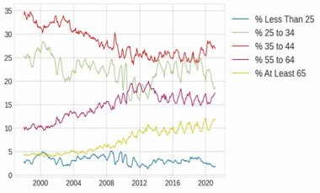
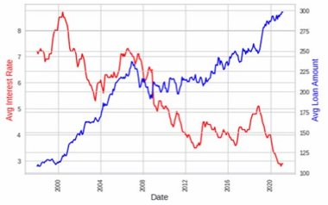
EDA - Visualization
% of Borrowers by Age:
Increase in borrowers at least 65 y/o
Decrease in borrowers 35-44 y/o
Interest Rates vs Average Loan Amounts:
Possible Negative Correlation
Notes:
The last part of EDA, leading into feature selection, was creating some visualizations to see how the features worked in sync - or didn’t. Here we have a couple of the more interesting charts –
The first is the percentage of borrowers by age and we can see that from 2008 to 2012, there was a noticeable increase in the average amount of borrowers at least 65 years old.
However, the percentage of borrowers in the 35 to 44 age range has steadily decreased since 1998.
The second chart has a dual axis showing the trends of the average interest rates against the average loan amounts. It’s an interesting visualization of what we might have guessed from experience –
The interest rates have trended down since 1998, hitting the lowest of lows in 2021, while the average loan amount has done just the opposite – risen higher than ever.
This points to a high negative correlation and that these two will be good features for selection.

Slide 7
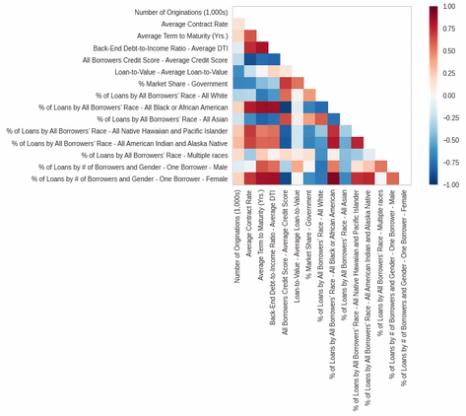
Feature Selection
High Positive Correlation:
Back-End Debt-to-Income Ratio – Average DTI and Average Contract Rate
Loan to Value – Average Loan to Value and % Market Share – Government
% of Loans by # of Borrows and Gender – One Borrower – Male and % of Loans by All Borrowers' Race – All Black or African American
High Negative Correlation
Back-End Debt-to-Income Ratio –Average DTI and All Borrowers Credit Score – Average Credit Score
Loan to Value – Average Loan to Value and All Borrowers Credit Score – Average Credit Score
Average Contract Rate and All Borrowers Credit Score – Average Credit Score
Notes:
Next, I calculated correlations across multiple features and using that information, I narrowed down those data points and created this matrix of correlation.
This provides insight into the data that we may have missed in the raw data.
We see there are relationships with very high positive correlation denoted by the deep red color, such as Back-End Debt-to-Income Ratio – Average DTI and Average Contract Rate.
Likewise the dark blue color indicates a high negative correlation, like with the Average Contract Rate and All Borrowers Credit Score – Average Credit Score.

Slide 8
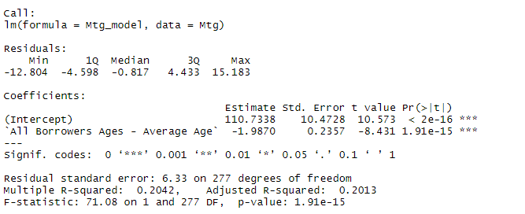
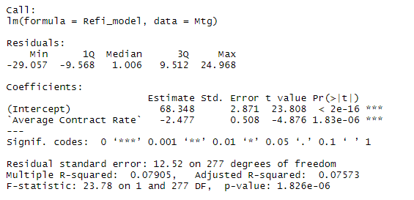
Model Implementation - Linear Regression Models
With the model fitted, we can see that as the average borrower age increases by 1 year, the percentage of Originations that are for First Time Homebuyers goes down by 1.987 points, which is what we would expect.
Here we see that for each point that the Average Contract Rate (Interest Rate) goes up, the percentage of Originations being from Refinances goes down 2.477 points, which is expected.
Notes:
As a segue from the feature selection to the model implementation step, I created a few simple linear regression models with various features that I wanted to know more about.
The first model was to see the percentage of Home Purchase Originations being from First Time Homebuyers as predicted by the Average age of all borrowers on the mortgage.
With the model fitted, we found that as the average borrower age increases by 1 year, the percentages of Home Purchase Originations being from First Time Homebuyers goes down 1.987 points.
Considering people tend to buy their first houses earlier in life, this follows what we would expect.
The second model was to see the percentage of mortgage Originations being from any kind of Refinancing as predicted by the Average Contract Rate of the loan, i.e. average interest rate.
When we fit the model, we see that for each point that the Average Contract Rate goes up, the percentage of mortgage Originations being from any kind of Refinancing goes down 2.477 points.
Since a typical reason for refinancing is to take advantage of lower interest rates, this also tracks with our expectations.

Slide 9
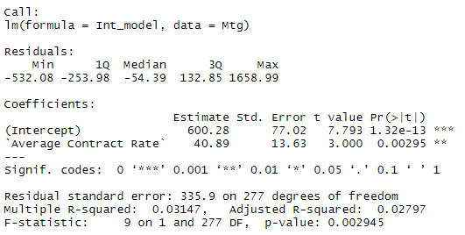
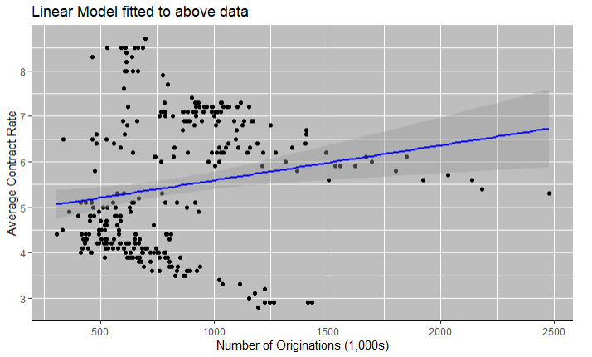
Originations Predictions – Linear Model
With the model fitted, we can see that as the Average Contract Rate increases by 1 point, the Number of Originations (1000s) goes up by 40.89 points. This is unexpected.
The points on this graph create two clusters – one above 5.5% Average Contract Rate, and one below
Notes:
I then created a model to see the Number of Originations by the 1000s as predicted by the Average Contract Rate, or average interest rate. This provided surprising results.
When the model was fitted, we saw that as the average contract rate increased by 1 point, the number of Originations by the 1000s increased by 40.89 points!
Considering most people tend to avoid new mortgages when interest rates are high, this was an unexpected result.
I then plotted this model and found something interesting – the points on the graph created two distinct clusters – one above the Average Contract Rate of 5.5% and one below.

Slide 10
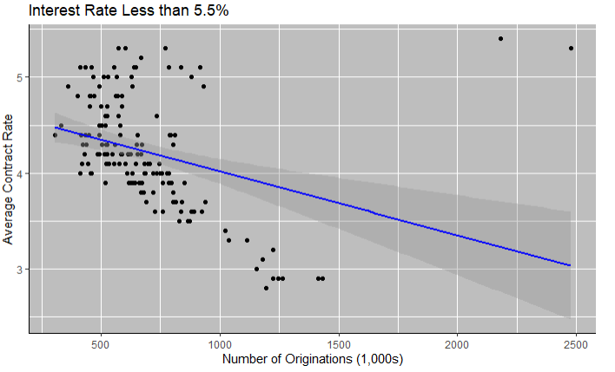
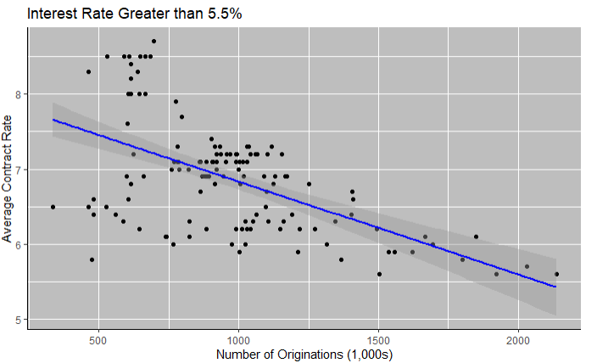
Originations Predictions – Linear Model
When the data is split into two groups with interest rates greater and less than 5.5%, we see a different trend emerge – a negative slope. This correlates with our prior chart at the intersection of the two data lines in the year 2009.
Notes:
Using this information, I split the data into two groups – one with interest rates greater than 5.5% and one with interest rates lower than 5.5% and re-ran the models.
Once plotted, these tell a much different story.
We see in both models that as interest rates decrease, the number of originations by the thousands INCREASES.
When we look back at the previous chart between the Average Interest Rate and Average Loan Amount, we see that the two lines cross at almost the exact point of 5.5% interest rate, and we can see that this occurred in 2009.

Slide 11
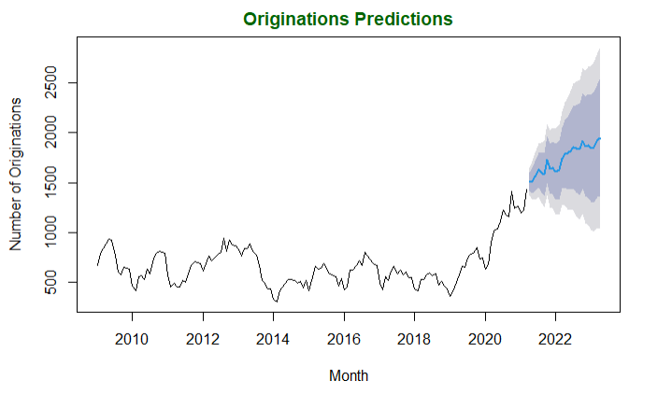
Originations Predictions – ARIMA Model
March 2022: 1744
Low 95: 1275
Low 80 : 1438
High 80: 2051
High 95: 2214
April 2022: 1787
Low 95: 1272
Low 80 : 1450
High 80: 2124
High 95: 2303
May 2022: 1793
Low 95: 1235
Low 80 : 1428
High 80: 2158
High 95: 2351
June 2022: 1818
Low 95: 1220
Low 80 : 1427
High 80: 2209
High 95: 2416
Notes:
Based on this new information, I built an ARIMA model to predict the number of originations through April 2023 using data from 2009 and forward.
ARIMA stands for “autoregressive integrated moving average” and it is used to measure events that happen over a period of time and predict future data in a series.
This model supports the findings from the initial Linear Regression model, that the average number of originations is predicted to continue to rise over the next year IF the interest rates remain constant.
Keep in mind, however that there is a margin of error.
To give more color to the calculations, I provided the lowest and highest 80th and 95th prediction intervals, based on a normal distribution.
For example, in April of 2022, there’s a 95% probability that the number of originations by the thousands will be at 1,272 or more; however, there’s a 95% probability that the number of originations by the thousands will be 2,303 or less.

Slide 12
Challenges
The COVID-19 pandemic has affected all markets, and there is little to no historical data from prior global pandemic in 1921, so predictive models cannot account for this as well.
Each geographic area has its own housing market. While averages and trends can be identified for the nation, as done here, specific markets need to be studied individually.
Many factors go into real estate markets and mortgage originations – inflation, government regulations, global crises, local demographics, available inventory, etc. It is near impossible to take everything into consideration, so contributing factors may not be fully considered here.
Notes:
Now, there are challenges to any project, particularly when in an effort to predict an event.
In this case, we are barely on the back end of a global pandemic that completely changed the trajectory of nearly every industry in the world, and mortgages were no exception.
While there was a similar past event to draw parallels with in 1921, the data from the last global pandemic is rare, if nonexistent, so including it in the models was not possible.
Also, in the real estate markets, every geographic area will have its own “micro-market” and while national averages and trends can be identified and predicted - as with our models here – if a specific market needs evaluation, new data and models would need to be studied.
Lastly, much with other large industries, many many MANY factors can affect the mortgage industry – inflation, government regulations, global crises, local demographics, available inventory, etc.
Since it’s nearly impossible to take all things into consideration, there are certainly contributing influences that were not factored into this project.

Slide 13
If interest rates stay constant, the number of originations will continue to rise
If inflation causes the interest rates to rise, the number of originations per month will begin to drop.
Conclusions
Notes:
From the models I created with the information provided, I’ve concluded that:
- If the average interest rates stay constant, the number of originations will continue to rise and mortgage companies should prepare as needed, whether it’s additional marketing, increased budget for overtime or new employees, or even just adjusting their business investments to match an influx of revenue.
- However, if the current severe inflation rates cause average interest rates to increase, the number of originations per month will begin to decrease. This indicates lower revenue streams, and preparations for this may entail hiring freezes, lower raises and bonuses, and additional hedging strategies for mortgage companies.

Slide 14
Monitoring the inflation rates and subsequent interest rates will be crucial for determining next steps for mortgage company executives.
These models can – and should – be updated accordingly when new data becomes available, as this is an ever-changing industry.
Next Steps
Notes:
The future steps for mortgage companies will require monitoring the inflation rates and subsequent interest rates that will be affected.
The models and the predictions from them will need to be updated accordingly as new data becomes available.
As we saw with the various models, the most up to date information will be the most useful in predicting next steps in an ever-changing industry.

Slide 15
THANK YOU!
Notes:
Thank you for listening to my presentation, I hope you have learned something and feel prepared for the next months to come in the mortgage industry.
Have a great day!

